Slide 1

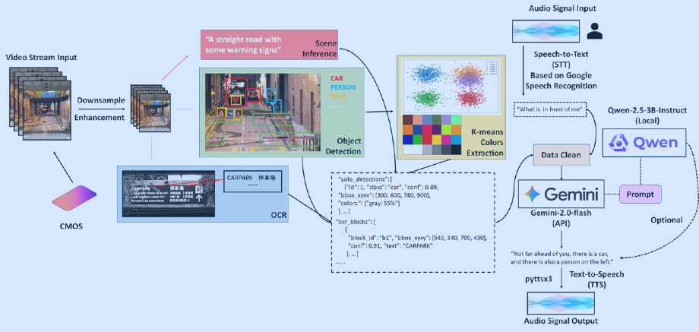
Visual Assistance System
Team: CV Warriors

Slide 2
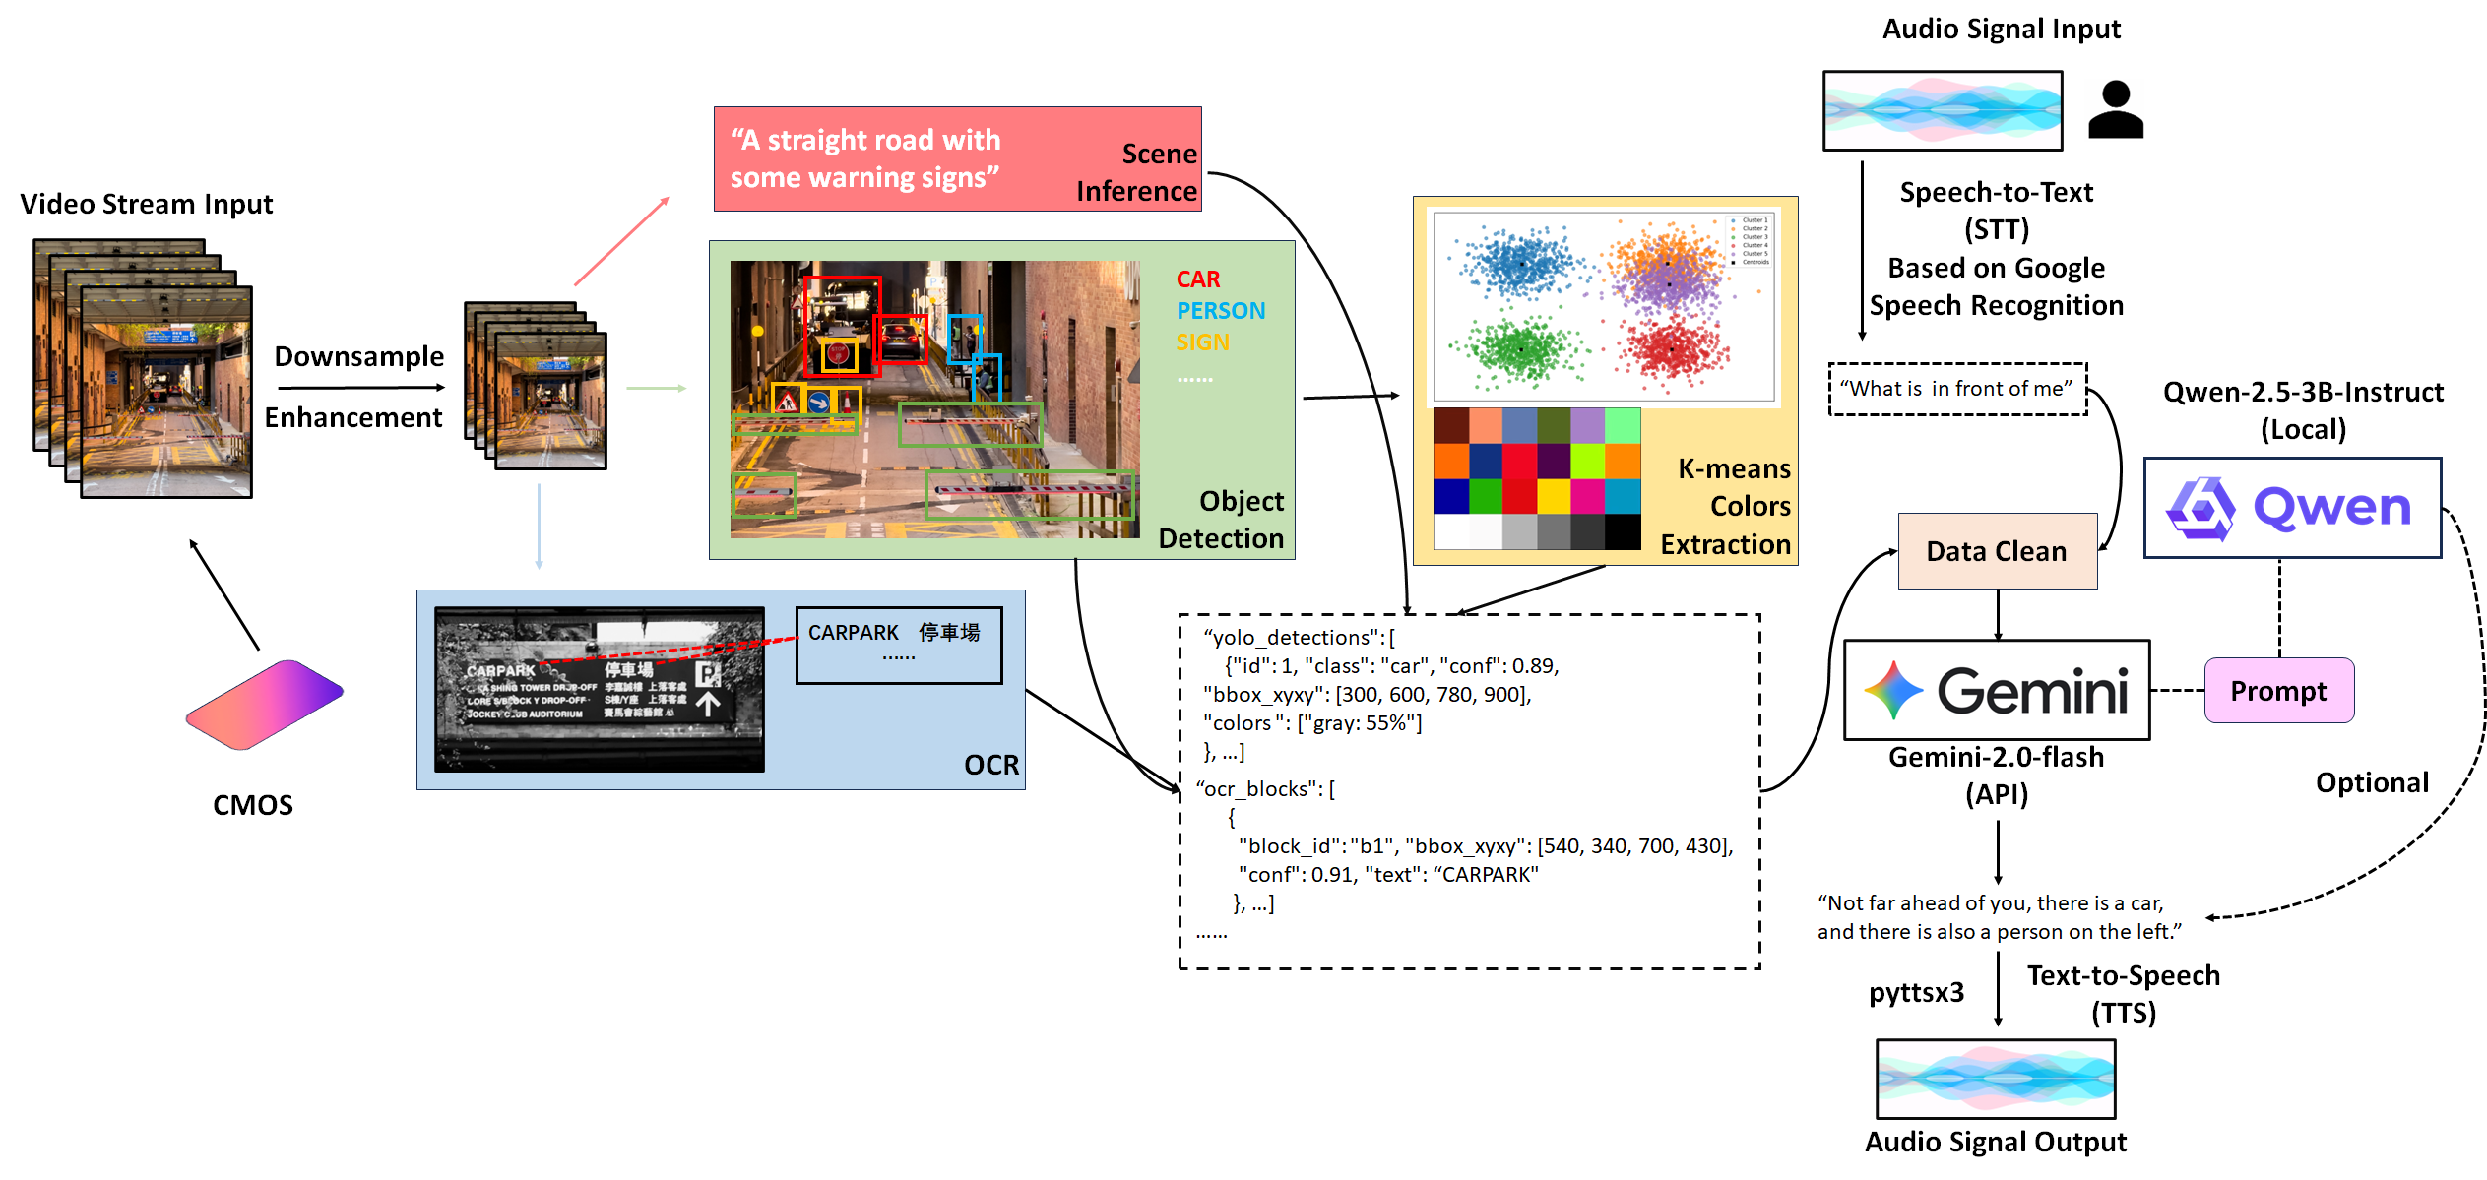

Slide 5

What is in front of me?
What color of the T-shirt?
Is there any obstacle in front of me?

Slide 6

Powerful Denoising Performance
Multi-language Equipped
Speech-to-Text (STT)
Based on Google Speech Recognition
>95%
<0.5s
Accuracy
Delay
Offline
Text-to-Speech(TTS)
Based on Pyttsx3
<0.1s
Delay

Slide 8
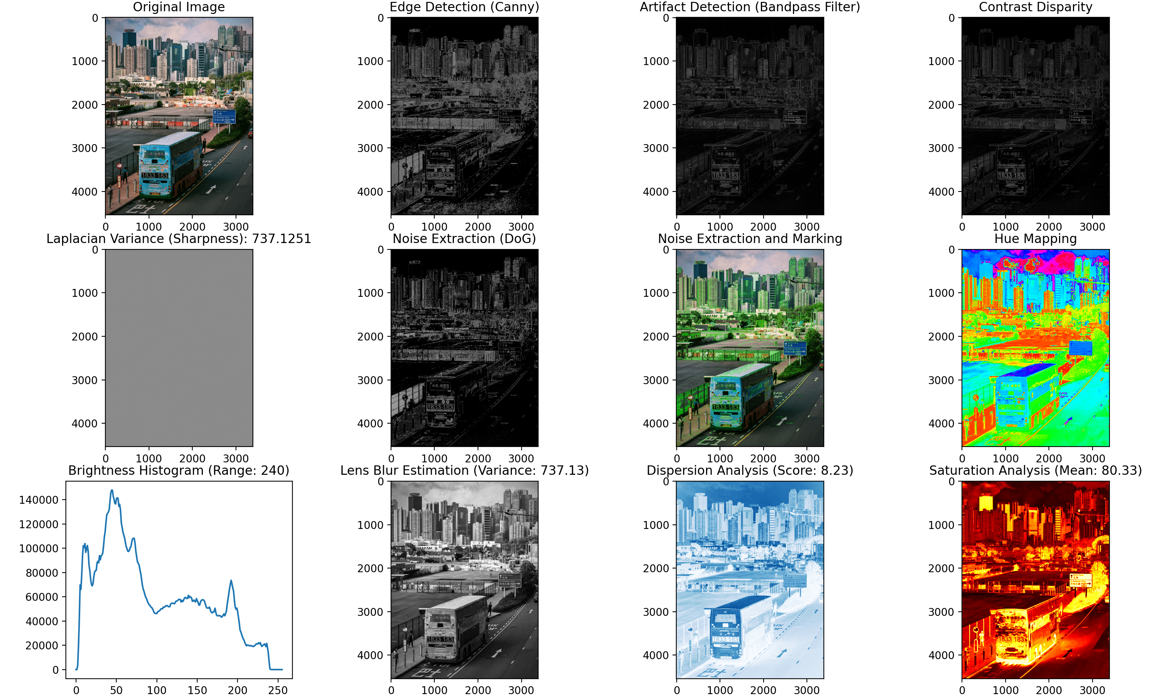

Slide 9
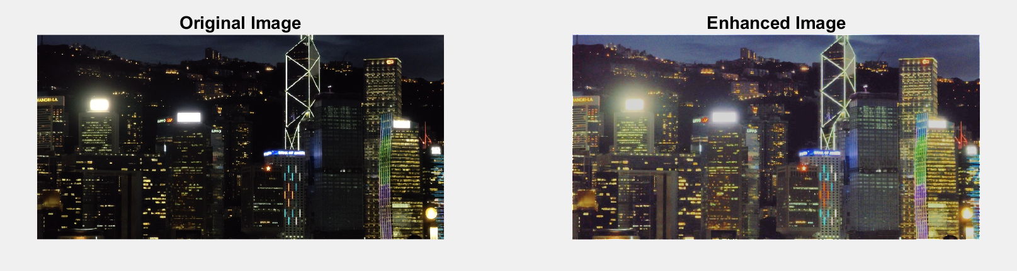

Slide 10
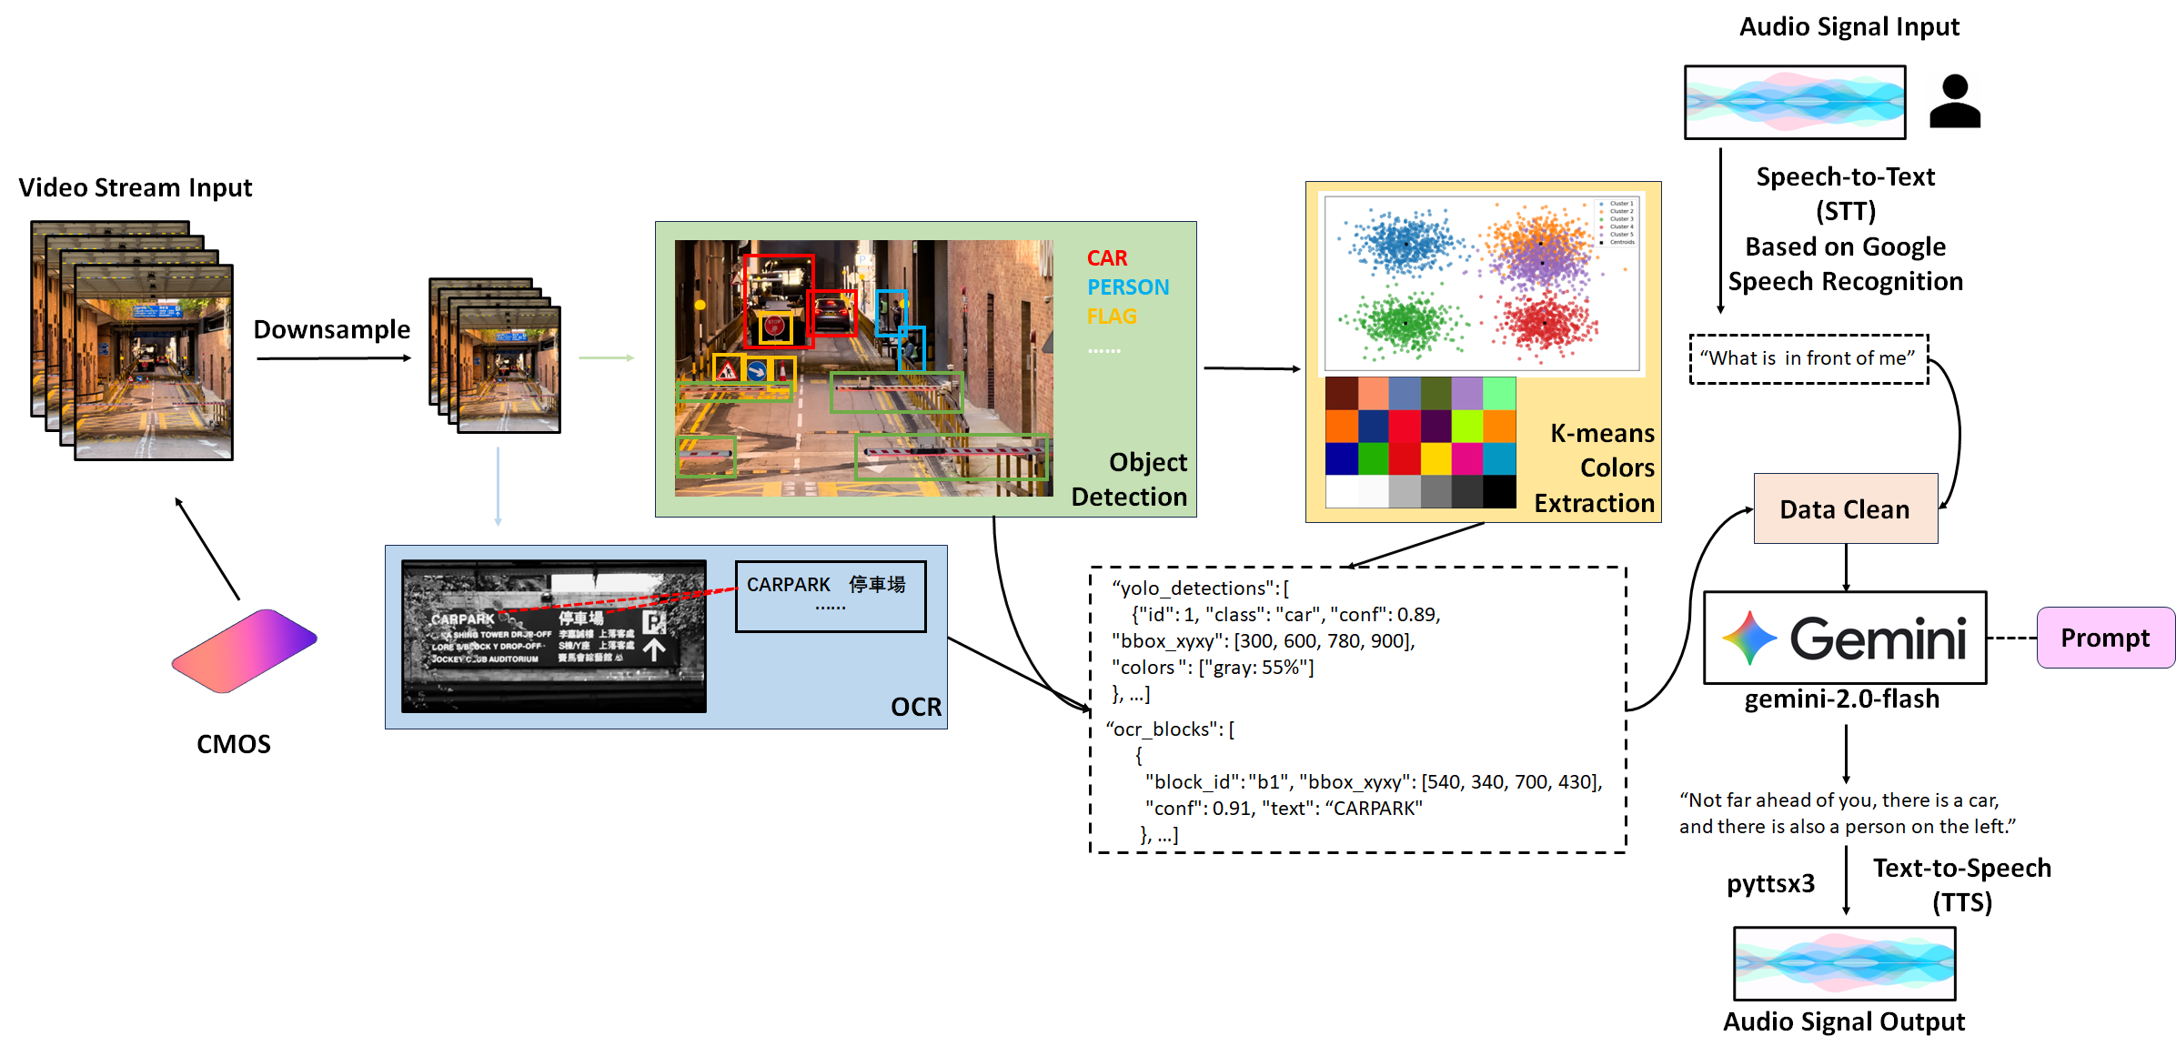

Slide 11
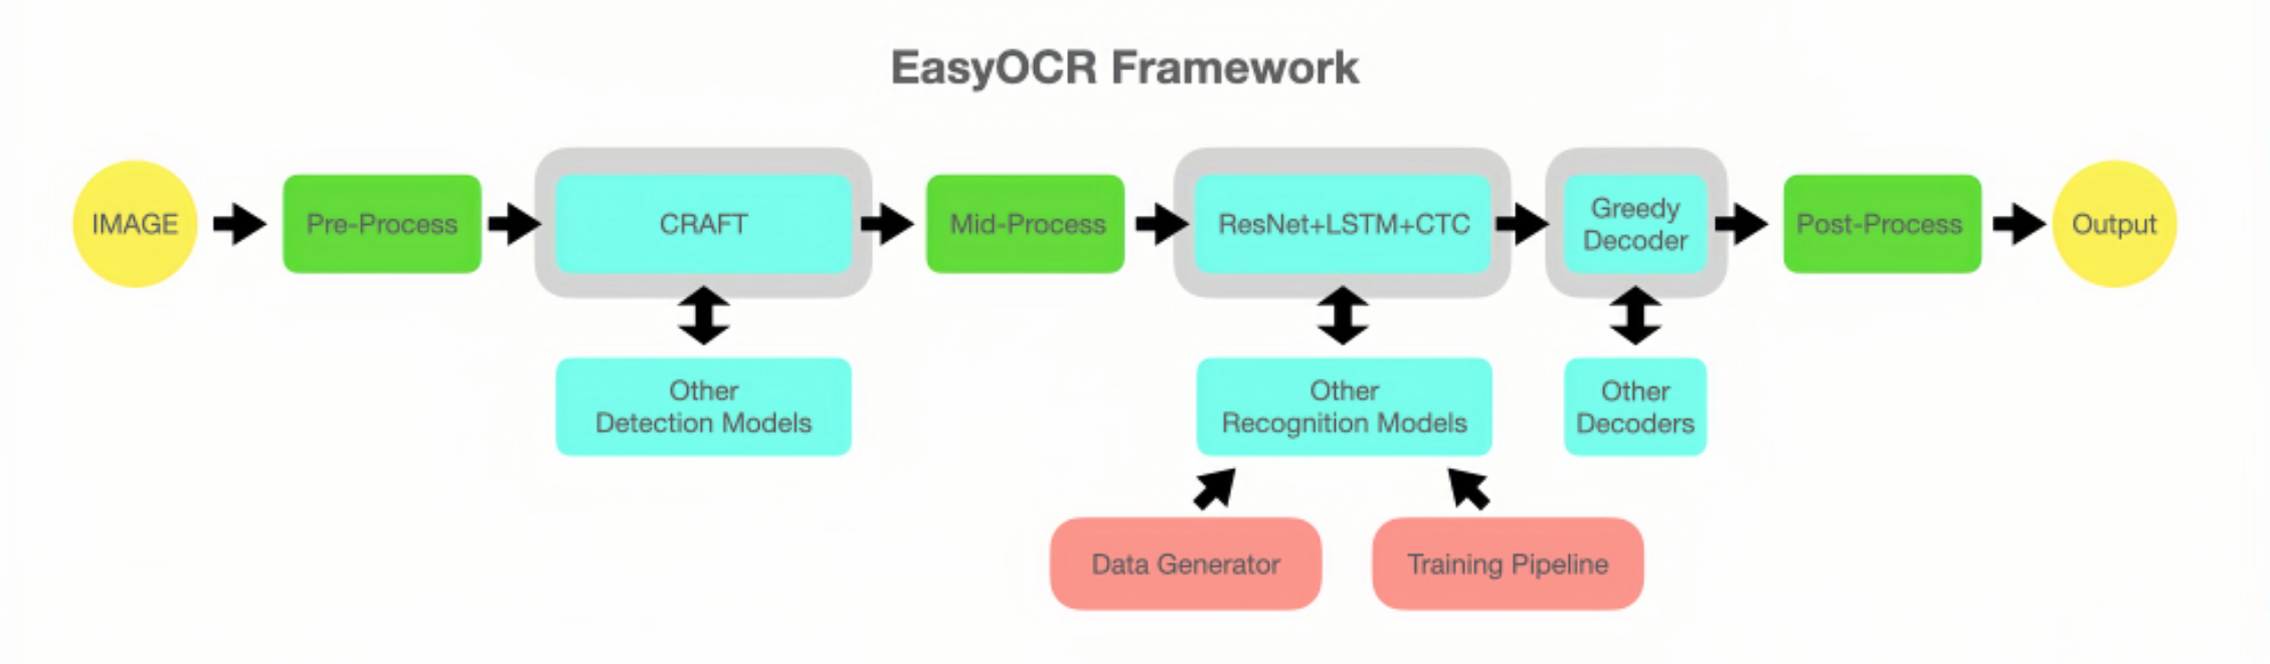

Slide 12
Source: EasyOCR official website

Slide 13
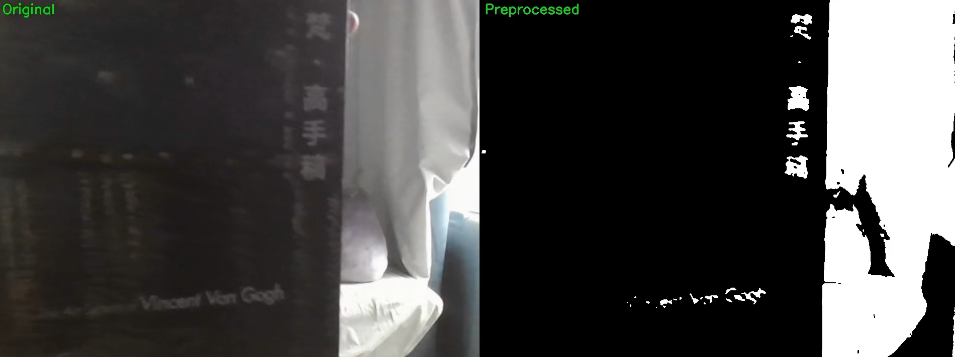
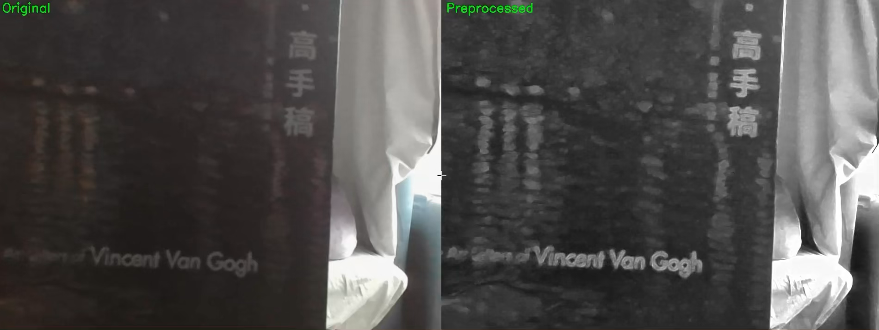
Binarization with Morphological Closing
Edge Enhancement (Sharpening + Morphological Gradient)

Slide 15

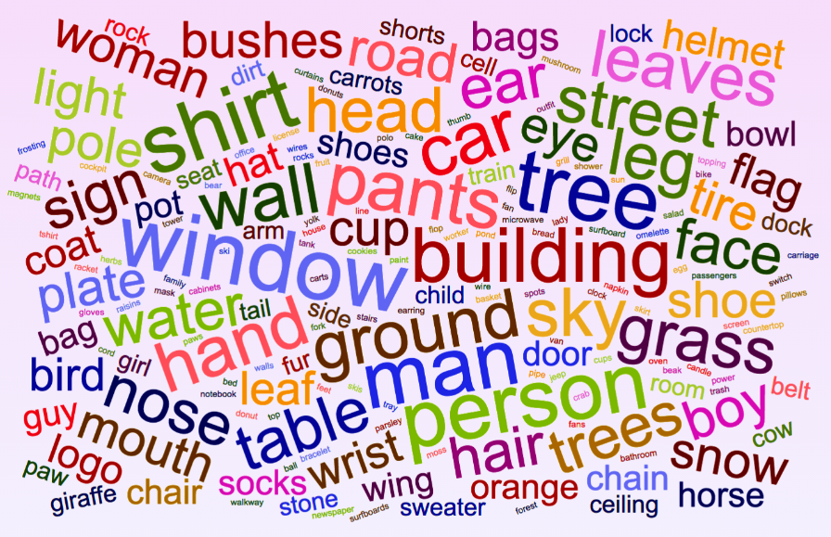
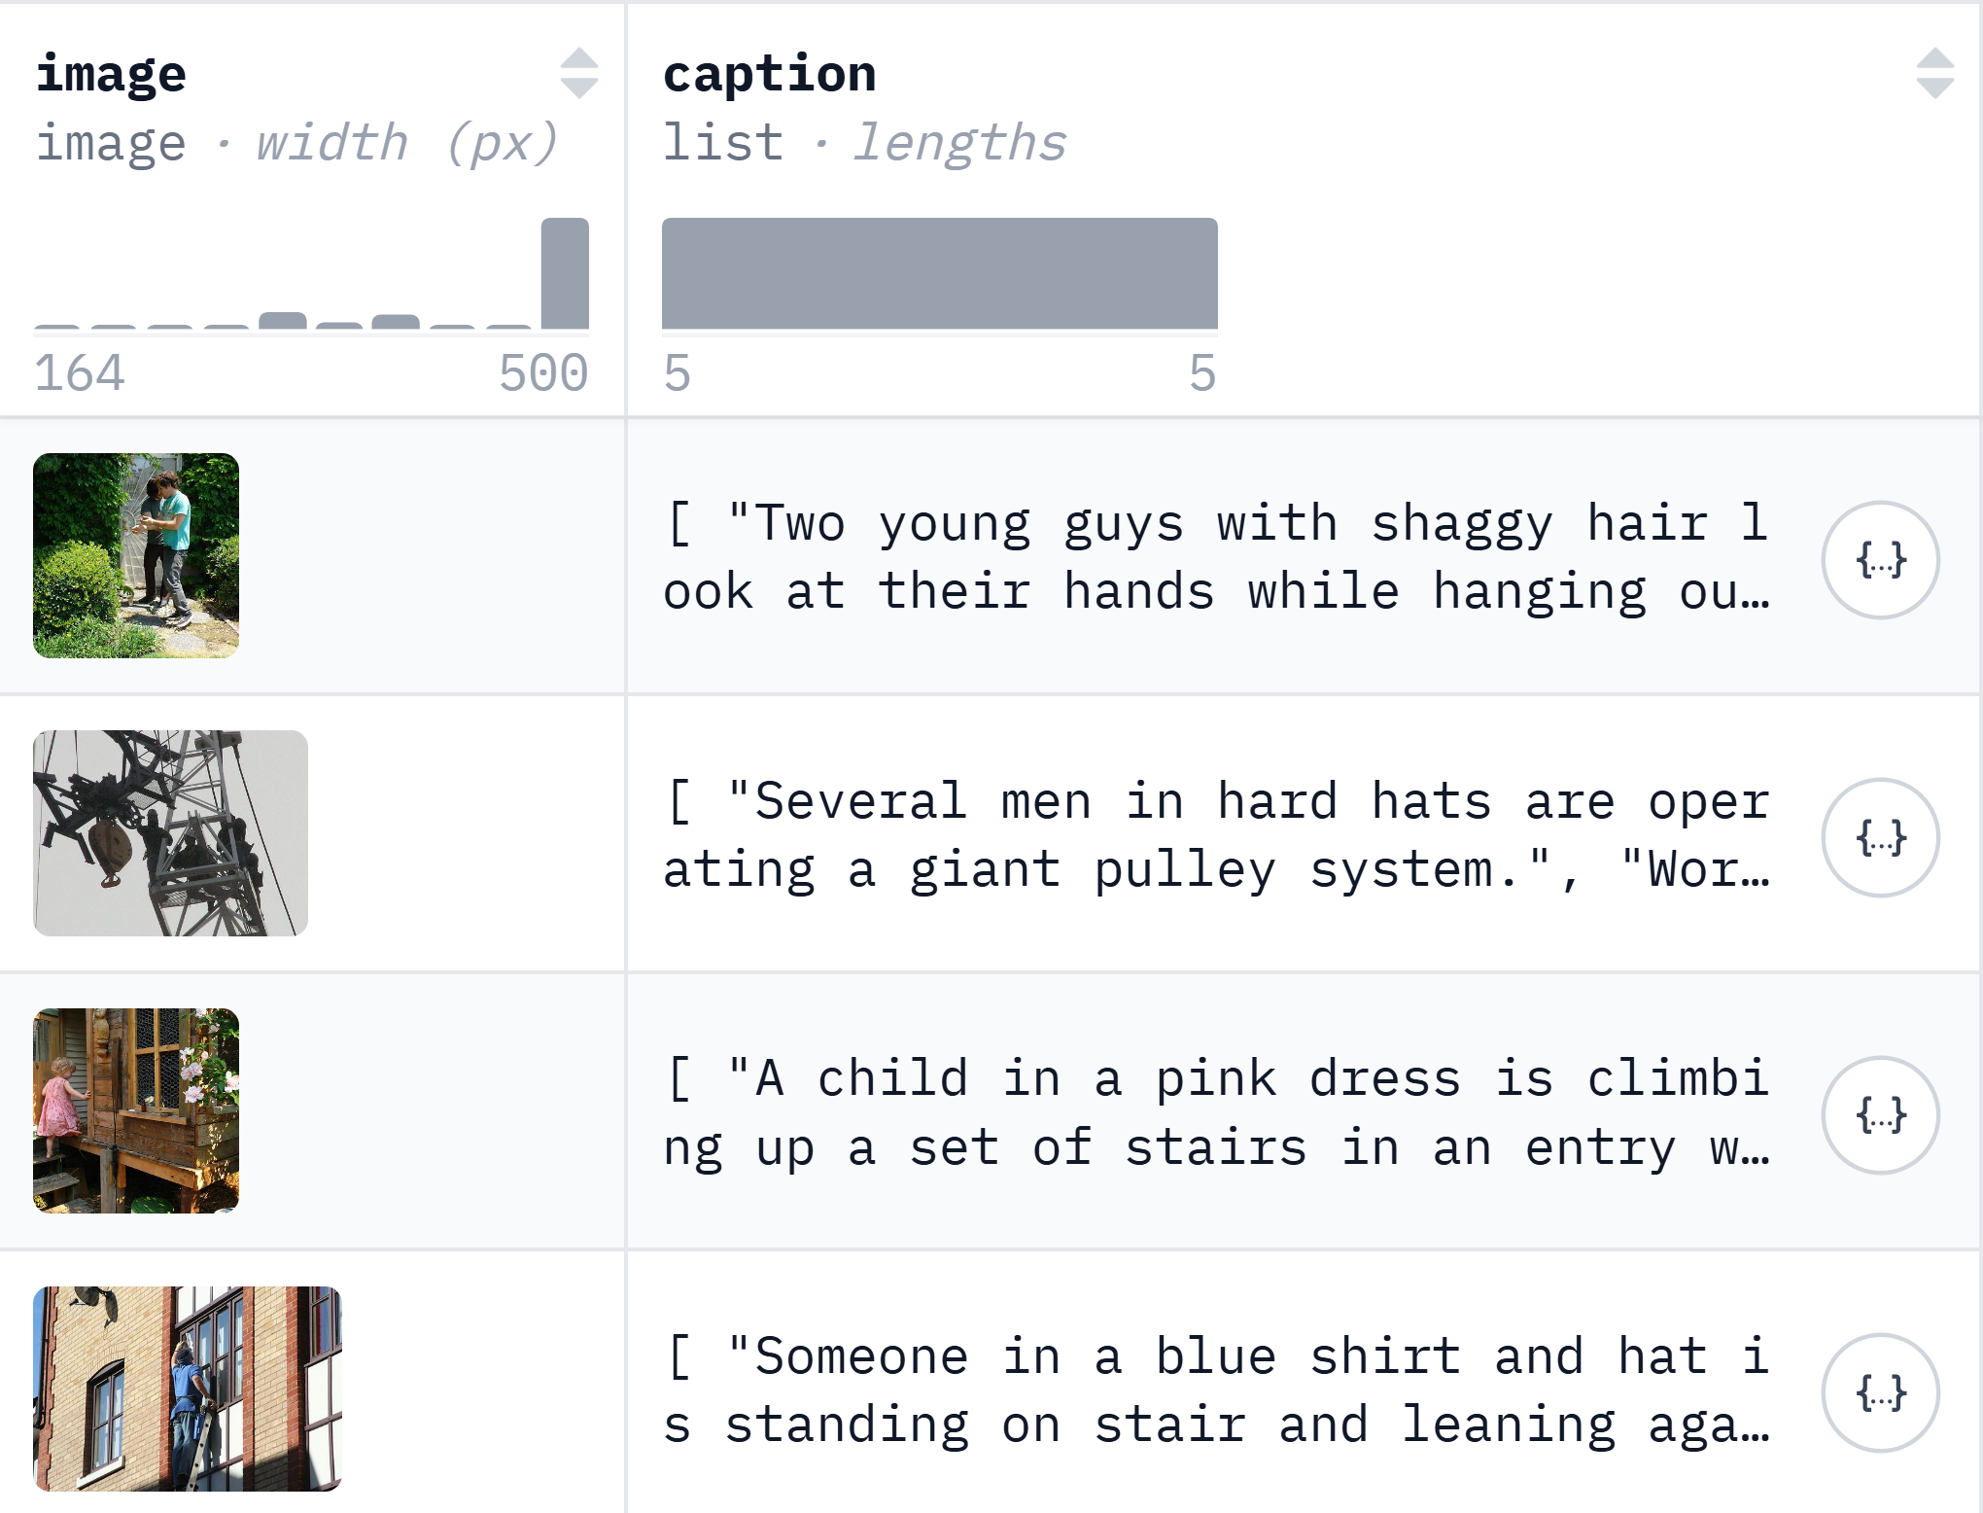
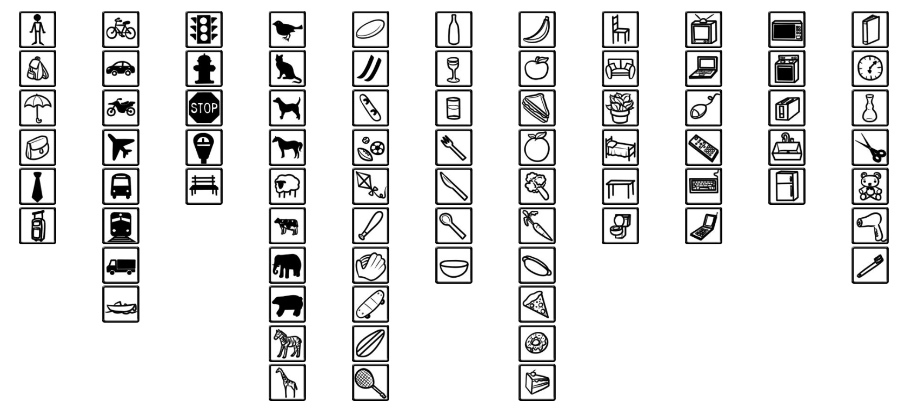
1.3M+
300+
Images (Total)
Category
14M+
Annotations (Total)
GQA
Source: GQA official website
Flickr (30K)
COCO 2017
Source: Flickr (30K) hugging face website
Source: COCO official website

Slide 16
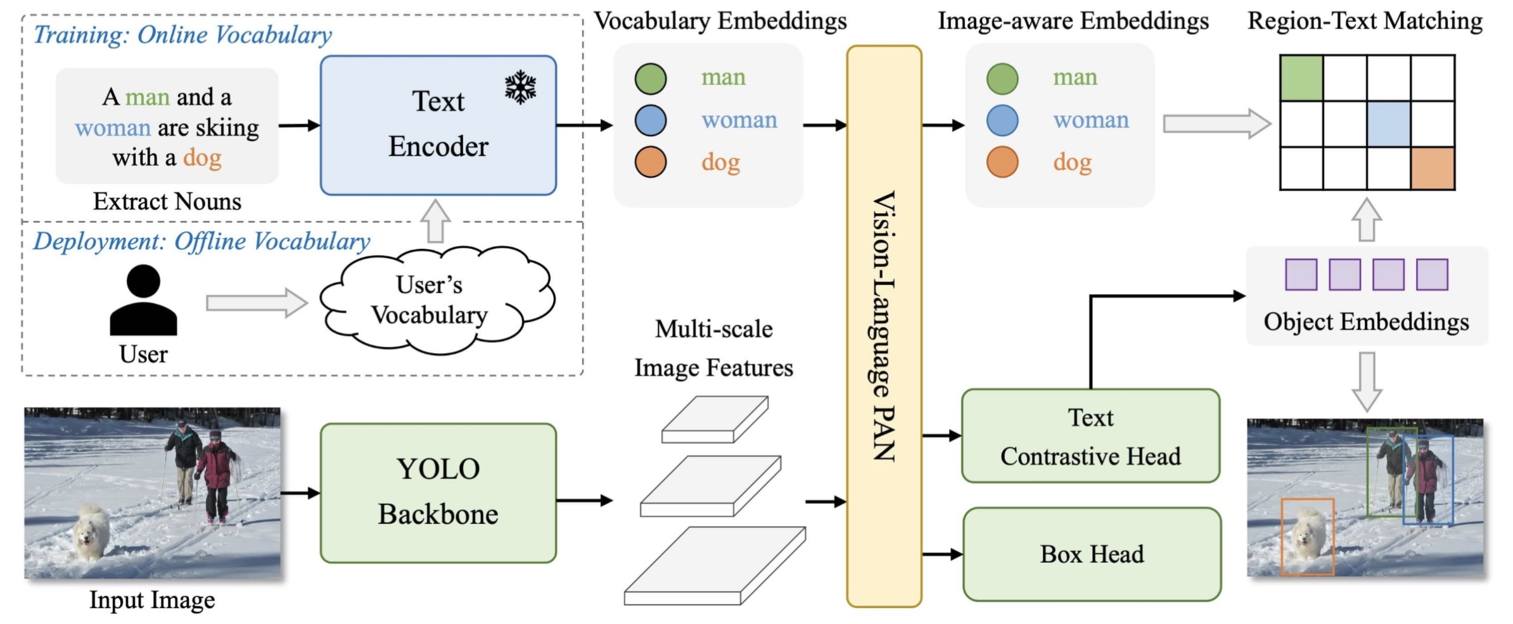
YOLO-World Architecture
Source: Cheng et al., “YOLO-World: Real-Time Open-Vocabulary Object Detection”

Slide 17
Source: Cheng et al., “YOLO-World: Real-Time Open-Vocabulary Object Detection”

Slide 18
Source: Cheng et al., “YOLO-World: Real-Time Open-Vocabulary Object Detection”

Slide 19
Source: Cheng et al., “YOLO-World: Real-Time Open-Vocabulary Object Detection”

Slide 21
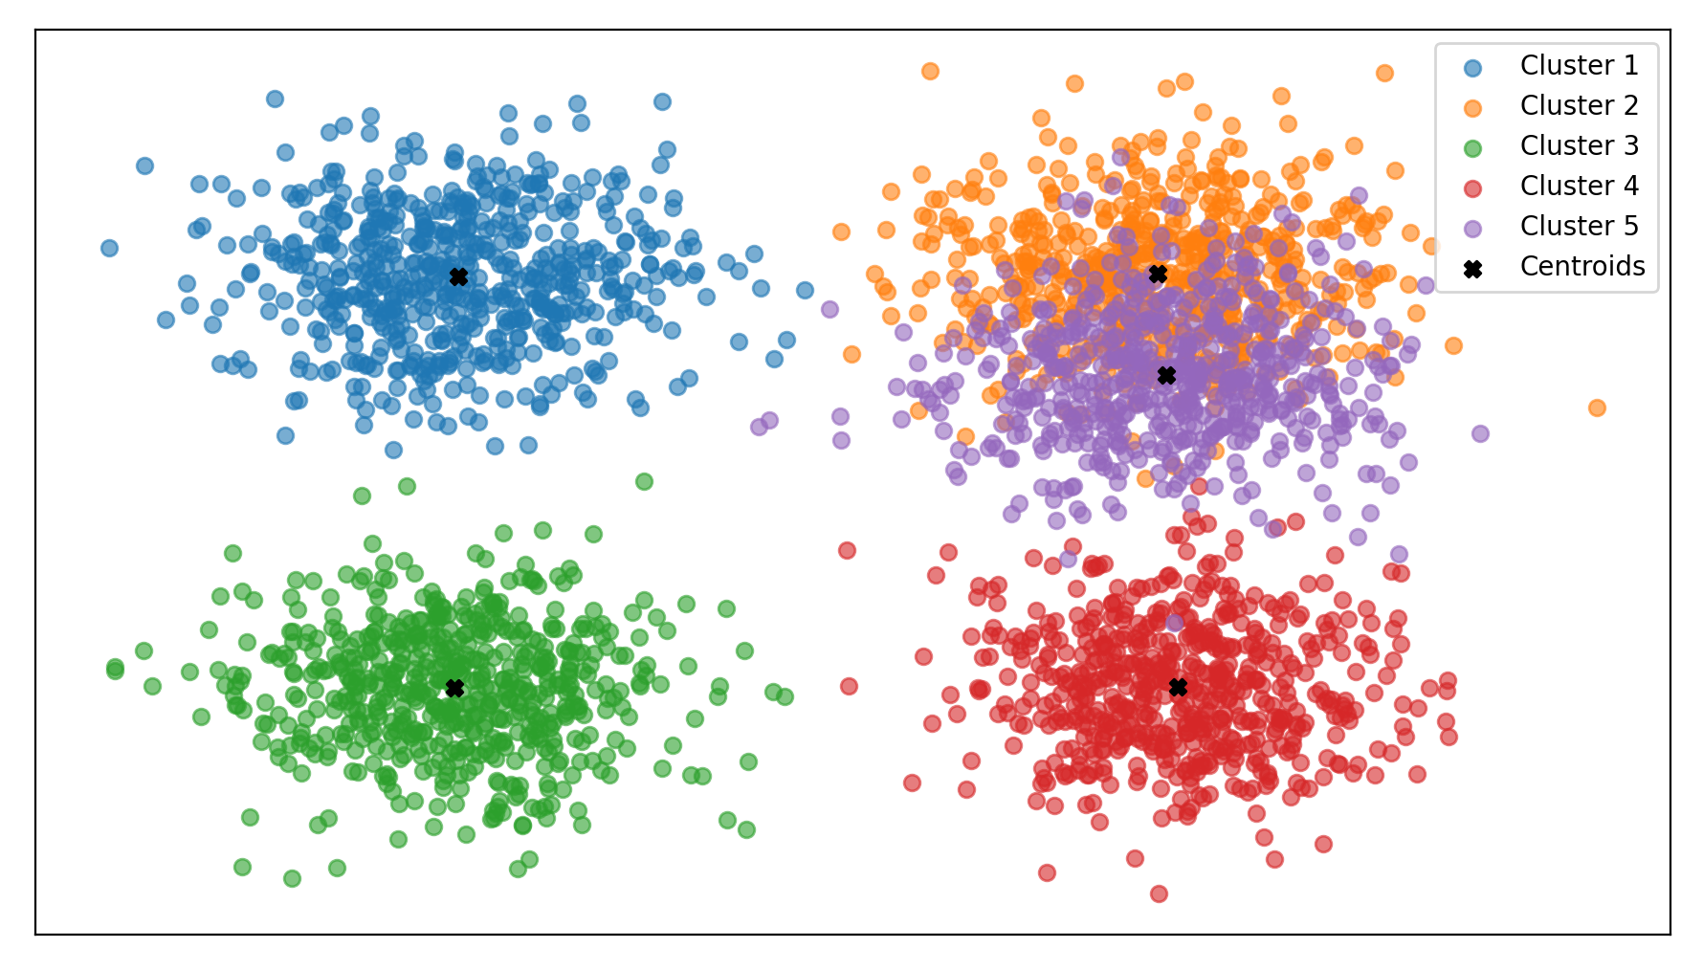
😃
Find the Similarity
Red: 57%
Purple: 39%
Color Card
(Example)
Black: 98%

Slide 24
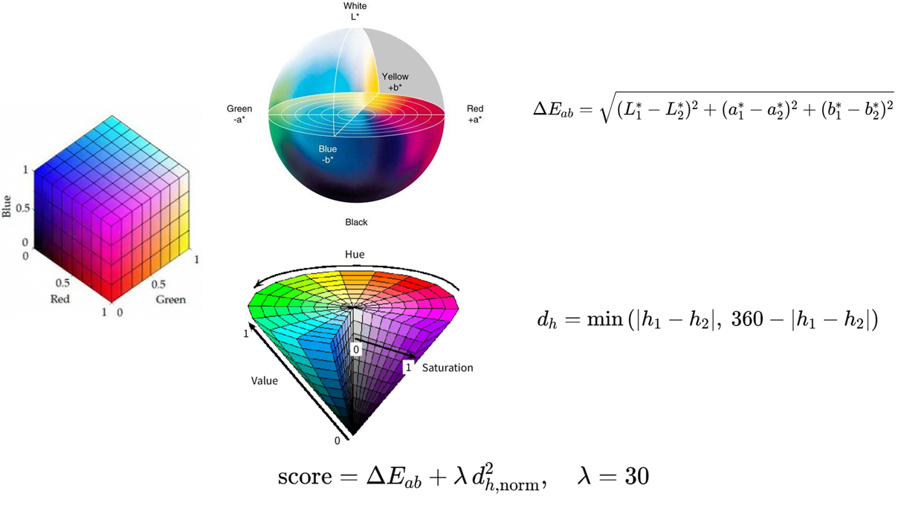
LAB
RGB
HSV

Slide 25
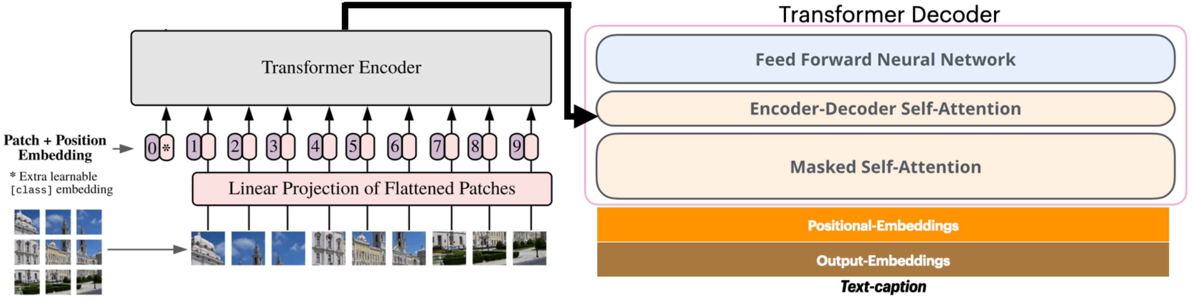
Vision Encoder Decoder Architecture
Source: Blog “The Illustrated Image Captioning Using Transformers” (ankur3107.github.io)

Slide 26
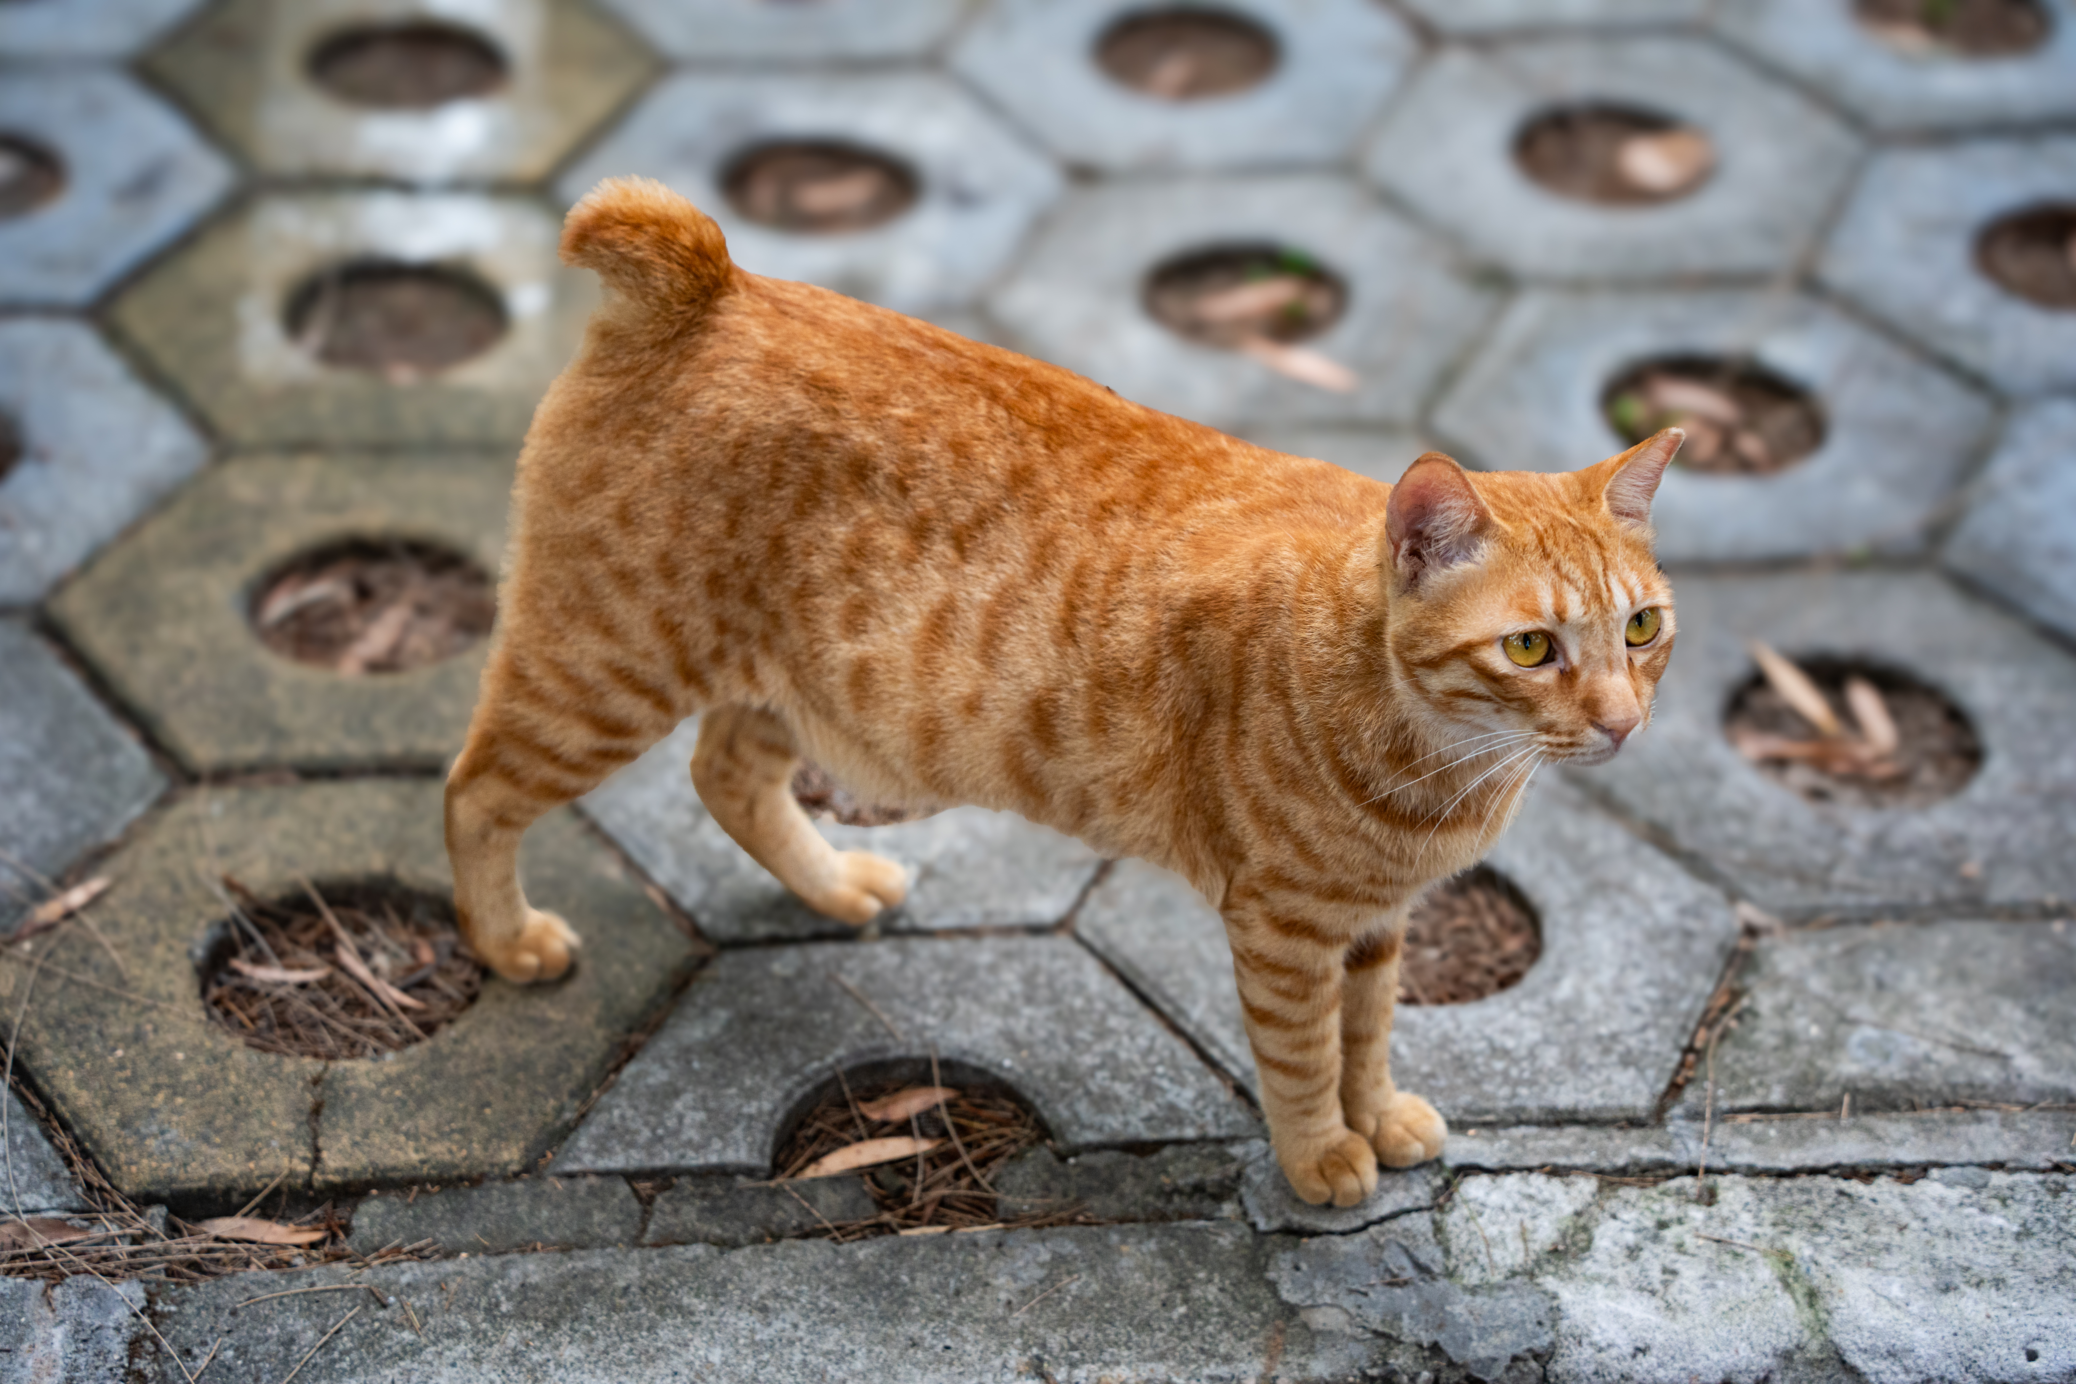


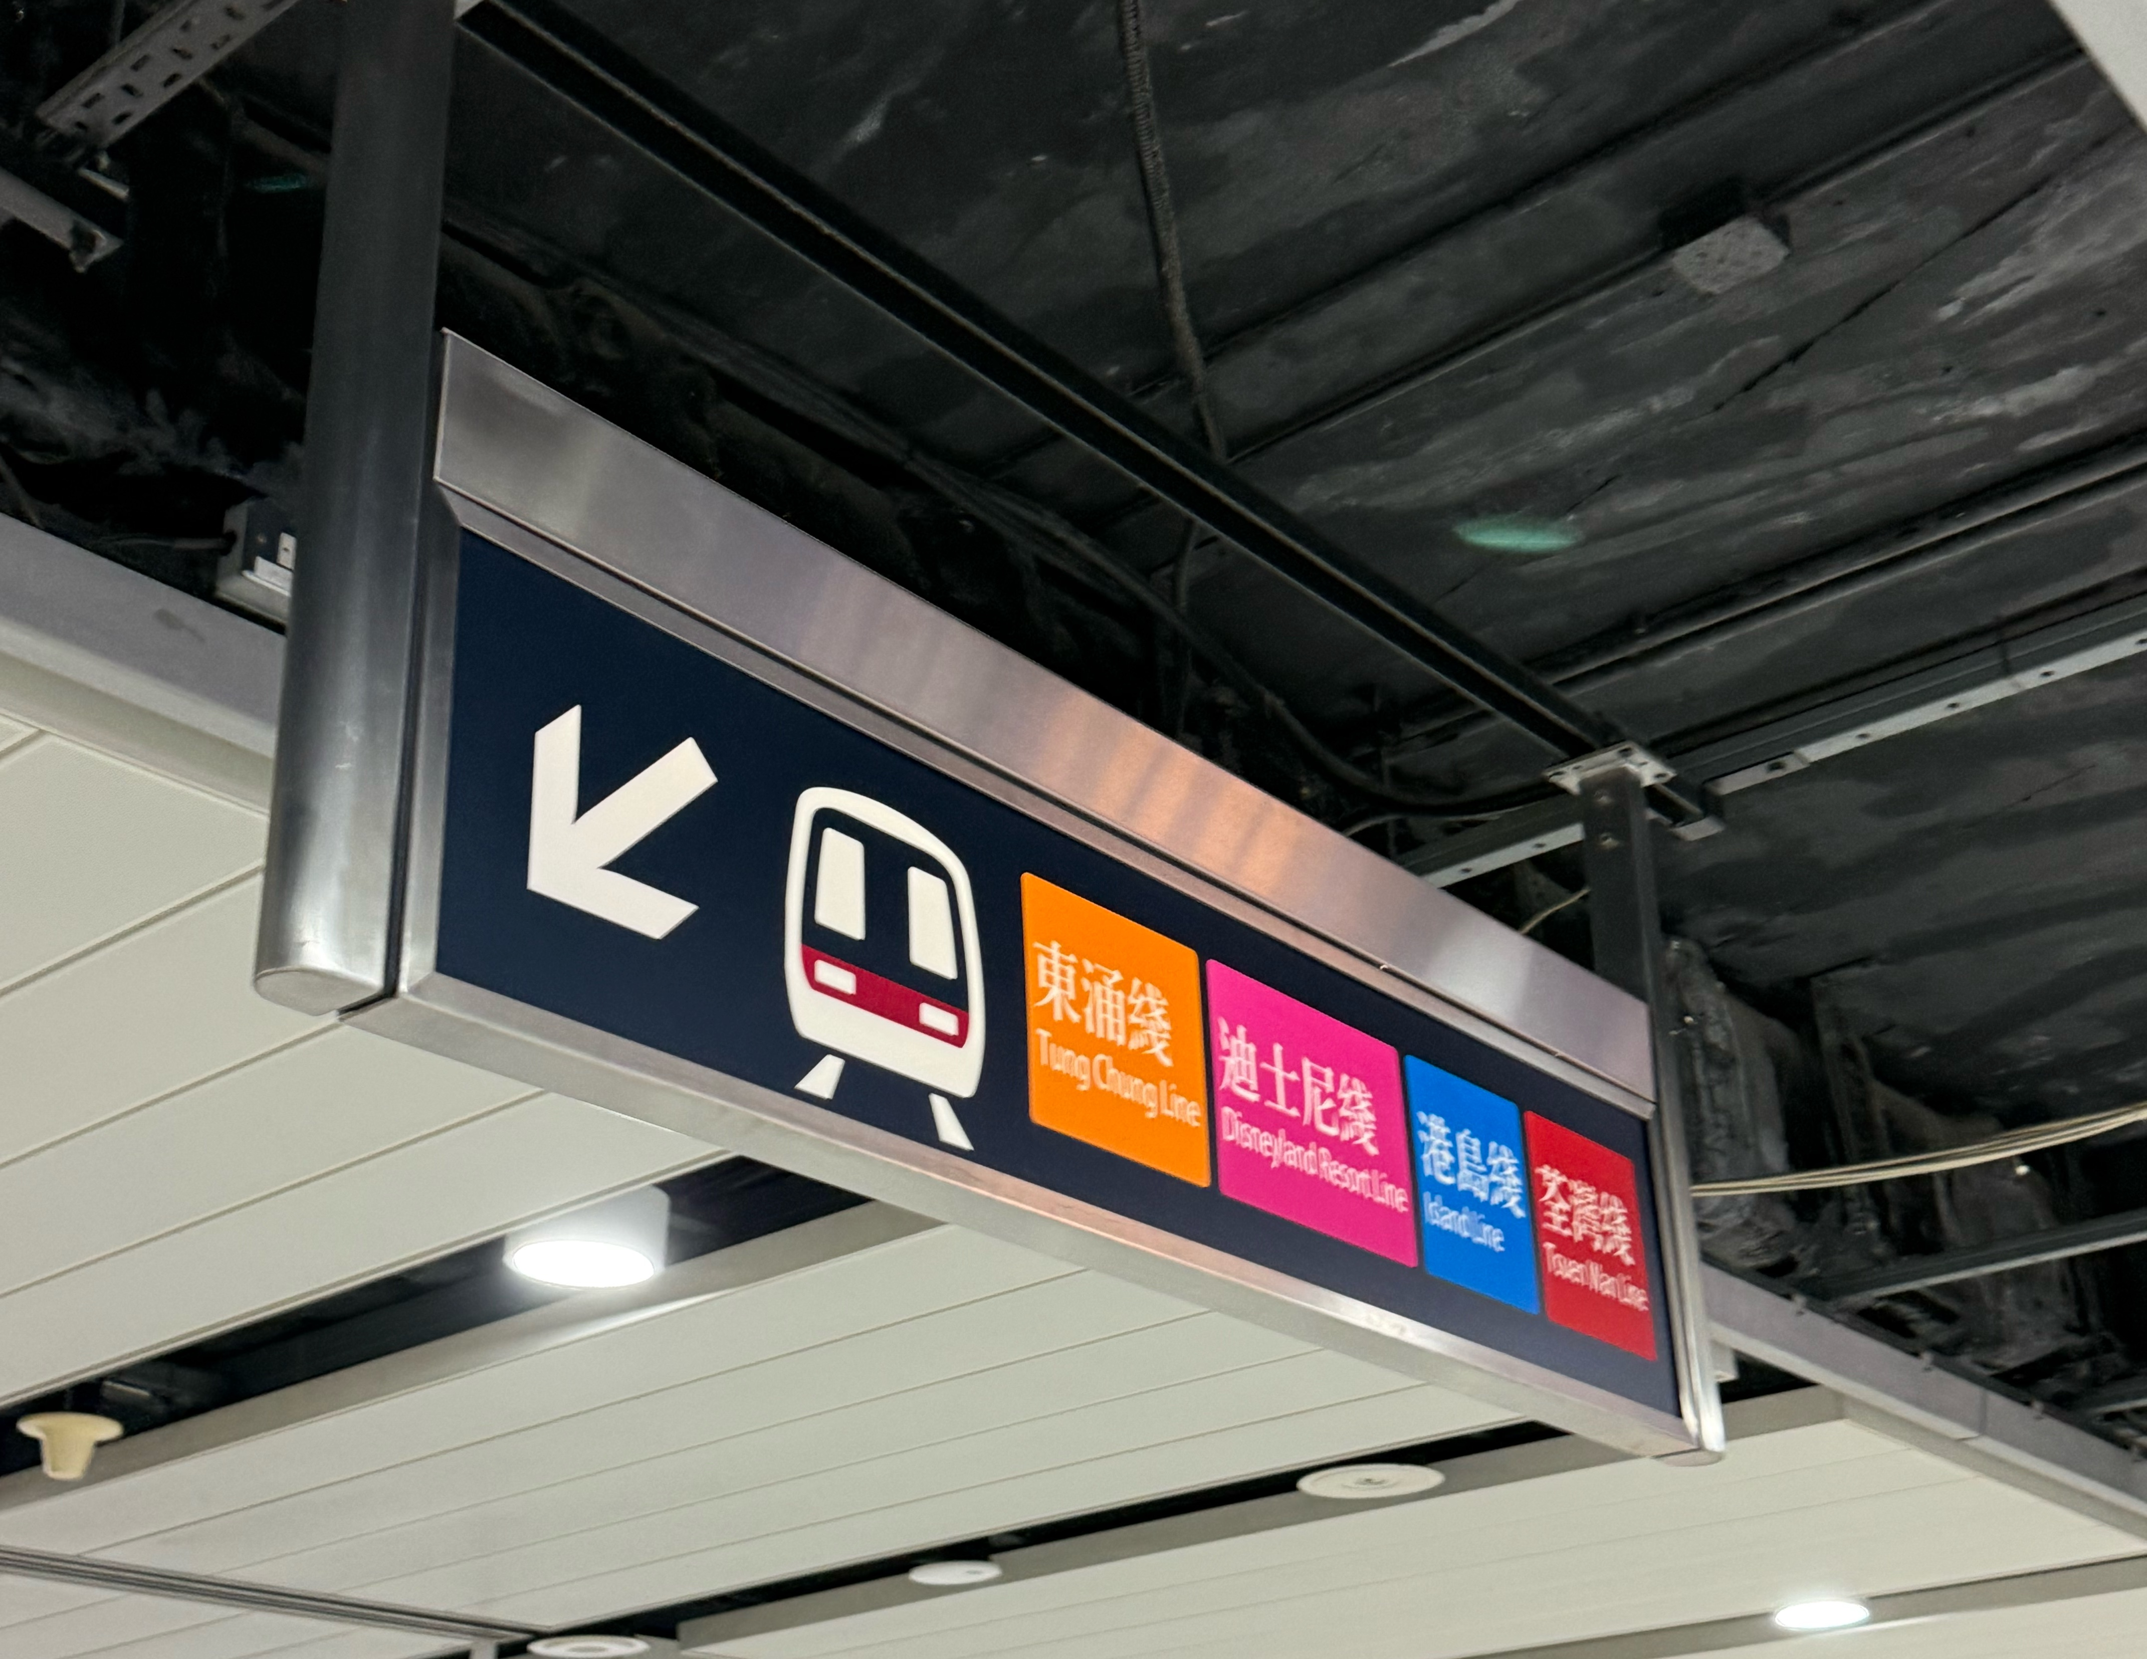
scene: a cat is on the ground
class: cat
confidence: 0.73
bbox: [99, 94, 537, 438]
colors: [‘brown’: 58%, ‘gray’: 21%]
Brown, Cat, Center
class: sign
confidence: 0.62
bbox: [432, 413, 461, 455]
colors: [‘orange’: 85%]
Gemini-2.0-flash
(API)
Qwen-2.5-3B-Instruct
Local
Orange, Sign, ‘TungChungLine’, Center
text: ‘TungChungLine’
confidence: 0.53
bbox: [437, 416, 458, 447]
scene: Some signs that is on top of a wall
……
……

Slide 27
By Sequence?

Slide 28
In parallel?

Slide 29
❌
❌
By Sequence?
❌

Slide 30
GIL
💡
😴
😴
😴
😴

Slide 31
😴
GIL
💡
😴
😴
😴

Slide 32
😴
😴
GIL
💡
😴
😴

Slide 33
😴
😴
😴
GIL
💡
😴

Slide 34
😴
😴
😴
😴
GIL
💡

Slide 35
Thread1
GIL
Thread2
Thread3

Slide 36
Thread1
GIL
Thread2
Thread3

Slide 37
Thread1
GIL
Thread2
Thread3

Slide 38
Thread1
GIL
Thread2
Thread3

Slide 39
Thread1
Thread2
GIL
Thread3

Slide 40
Thread1
Thread2
GIL
Thread3

Slide 41
💡
GIL
😴
💡
CPU
Operations
CPU
Operations
I/O
Operations
😴
I/O
Operations
Thread1
Thread2

Slide 42
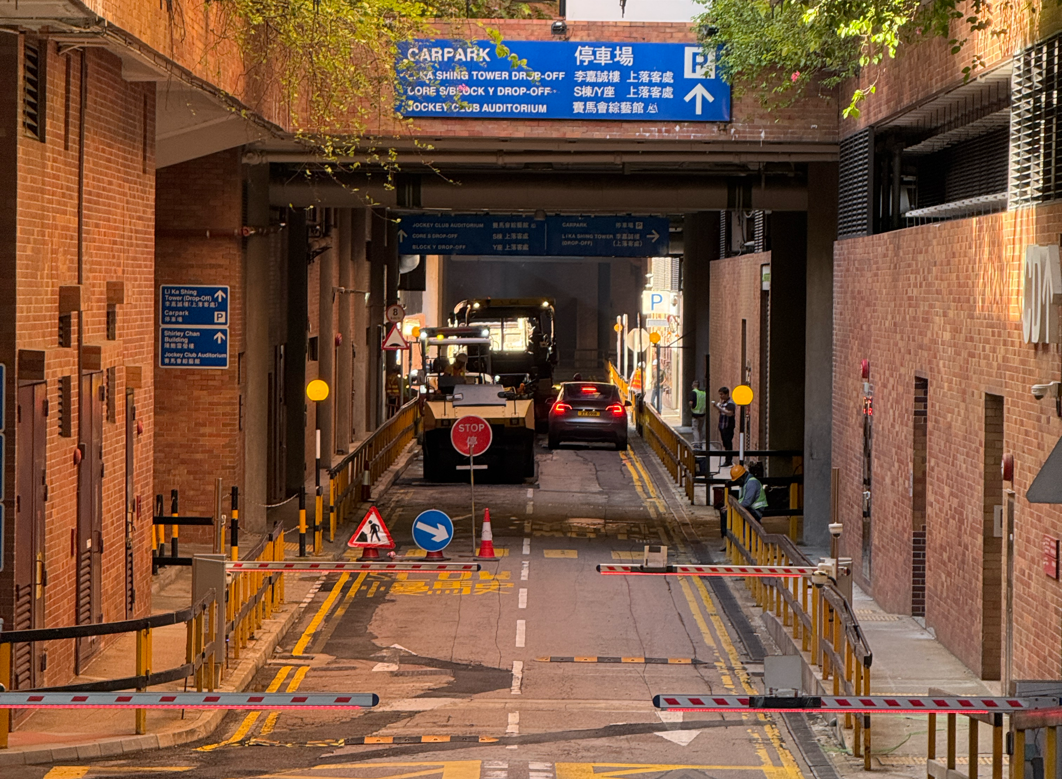
😴
GIL
😴
CPU
Operations
CPU
Operations
I/O
Operations
💡
I/O
Operations
💡
Thread1
Thread2

Slide 43
😴
GIL
😴
CPU
Operations
CPU
Operations
I/O
Operations
💡
I/O
Operations
💡
Thread1
Thread2

Slide 44
